Slide 1

Don’t wanna be an American Idiot!

Slide 2

Introduction
Coming from East Bay, California, the trio Billie Joe Armstrong, Mike Dirnt, and Tre Cool formed one of the most iconic Punk bands' Green day." Their debut EP, 1,000 Hours, was released under the moniker Green Day, also the title of one of their songs. Some fan sites say Billie Joe picked the name after "chilling in the basement of a Berkeley University building, "while others say it was the decision of the whole band. (Radio X, 2021) In 2004 Greenday locked themselves inside a studio for months experimenting with new sounds and breaking away from their comfort zone, coming up with 20 demos. But unfortunately, those demos with the title "Cigarettes and Valentines" were stolen. Instead of trying to rewrite the whole album, the band decided to start from scratch and came up with one of the most iconic punk rock albums of its era. The "American Idiot"

Slide 3

Composition
Pulling from themes set forth by the Who's Tommy and the Beatles' Sgt. Pepper's Lonely Hearts Club Band, Green Day embarked on their first rock opera concept record". (Alternative Press, 2018) Putting Jesus of suburbia as the lead character in the album. American Idiot, a concept album, was unfolding the coming of age of a teenager "Jesus of suburbia" living in the suburbs at the time of President Bush. Green day comments on the state of America through the eyes of Jesus of suburbia. The band found their political voice and released their manifesto: American Idiot. Billed as a "rock opera," the album was a sophisticated, horrifying portrait of America in the wake of the 9/11 attacks. (The Guardian, 2017). Coming off from the post 9/11 era, the band took the chance to address the country being over-saturated by media how the press directs people to live their lives, which is impossible to live to. They are tainted by the lies of politicians and speak up with the rebellious sense of a punk rocker. Songs like Are we the waiting and Homecoming serve as one Punk Rock anthems spurring out the monologue of the struggles faced by the teens of the modern world.

Slide 4

Story of the album
Jesus of Suburbia feels bored and alienated in his hometown (Jingletown) and moves to the city with his girlfriend Whatsername (or he meets her there, not sure on that detail). While there, he parties and gets fucked up a lot, but he doesn't find any meaning in it. Jesus then "meets" Saint Jimmy (who's just an alternate personality or himself), who's cool and charismatic and reckless. He uses this Saint Jimmy alter ego as an excuse to continue with his bad habits (drinking, drugs, etc.), and he thinks of himself as the savior of the poor, alienated kids in the city. Whatsername eventually gets sick of his act and the constant partying, so she leaves the city and him because she doesn't like the person he has become (Saint Jimmy). Whatsername leaving him is what makes him realize that he's gone down a dark path that he shouldn't have, so he metaphorically kills Saint Jimmy and moves back home to Jingletown

Slide 5
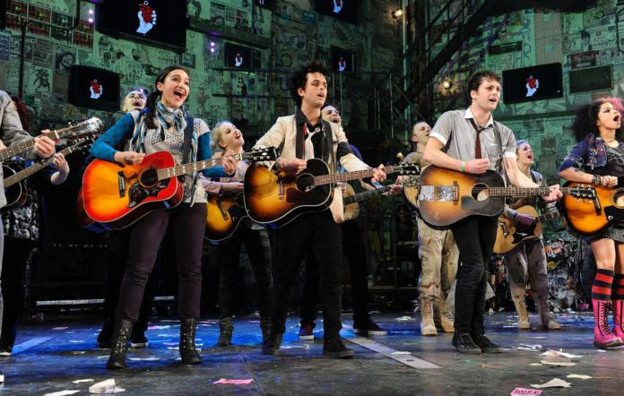
Socio-cultural impact
The long-term ramifications of 9/11 were still being felt across America and the world in 2004 when Green Day released their album American Idiot. With the prevalent language of the war on terror contributing to establishing a culture of fear and limiting the ability of voices of dissent to be heard, the primary musical response, in terms of mainstream genres, was understandably one of obedience rather than critique. On the other hand, Green Day resurrected the notion of punk rock as a genre that has always favored rebellious and confrontational stances and recorded a rock opera that chronicles the life and times of disgruntled youth in post-9/11 America through the exploits of a protagonist named Jesus of Suburbia. This album provided the catalyst for people to notice how the media portrays current events, such as the Iraq war and Bush's re-election. It also allowed the band to express their own opinions, even if they might be chastised for it. "I made [American Idiot] to give people a reason to think for themselves. [...] Maybe that's why it's difficult for me to write about politics now. Many things on that record are still relevant," says Armstrong in an interview with Rolling stones. They also wanted to clarify that there needs to be a shift in how America deals with its challenges. Armstrong says, "It's like we have this monarchy in politics – the passing of the baton between the Clintons and the Bushes. That's frightening. A complete change needs to happen, a person coming from the outside with a new perspective on all the f**ked-up problems we have.

Slide 6

Aesthetics
"Your utopia,my dystopia," says Armstrong in one interview. Dark black leather jacket, the brows, and short, wavy hair are colored jet black, and the entire outfit—skinny-tie, short-sleeved dress shirt, slacks, and tennis shoes also inky black. Green Day's sound has been compared to the Ramones, Sex Pistols, The Clash, The Dickies, and the Buzzcocks. The band's core genres are punk rock, pop-punk, and alternative music. The band has experimented in other genres such as skate punk, power pop, post-punk, pop-rock, and garage rock. Armstrong is the principal songwriter; however, he relies on the band's other members for organizational support. Hüsker Dü and the Replacements, two seminal hardcore-turned-alternative rock bands, have been recognized as one of Billie Joe Armstrong's biggest influences. Their influence can be seen in the band's chord structure.

Slide 7
Critical reception
The music critics overwhelmingly praised American Idiot. The album has score of 79 from Metacritic, based on 26 reviews, which provides a rating out of 100 to reviews from mainstream sources. Green Day is "probably the best-reviewed album of their career," according to AllMusic. Stephen Thomas Erlewine, the website's editor, lauded the album as "a collection of wonderful songs" or as a whole, adding that "it's something of a masterpiece" in terms of "musical strength and broad, politically charged narrative." It was praised by Pitchfork as "ambitious" and "effective" in conveying its message while "deliberately, tenaciously, and passionately on point" in its mood and manner. It was described by the NME as "an avalanche of different and delightfully good melodies delivered in an unexpectedly inventive manner." Green Day "makes the ride enjoyable enough," according to Entertainment Weekly, despite being built on a musical theatre concept "that frequently makes no sense." Some of the tracks were classified as uninteresting, and the album was criticized for focusing more on lyrics than music
. The album should have been a disaster, according to Rolling Stone, but the "individual tunes are aggressive and punchy enough to function on their own." "But a bright, splashy, even daring mess," the Guardian said of American Idiot. It was called a "pompous, overblown," yet "beautiful" concept album by Slant Magazine. Uncut was harsher, writing in a mixed review that "slam-dancing is still feasible" despite the album's heavy political focus. The Village Voice's Robert Christgau branded the album a "dud" in a scathing review. He added that "there's no economics, no race, hardly any compassion'' and asserted that Armstrong's lyrics displays "sociopolitical content" for "the emotional travails of two clueless punks. Ian Winwood of Kerrang! called it a "modern-day masterpiece."Josh Tyrangiel of Time said, "For an album that bemoans the state of the union, it is irresistibly buoyant."

Slide 8
Commercial performance
Green Day's first number one hit record in the United States, American Idiot, sold 267,000 copies in its first week of release, their best first-week sales week. The album went on to become the fourth best-selling album of 2005, selling over 3.4 million copies. American Idiot was in the top ten of the Billboard 200 for over a year after its release, spending 101 weeks on the chart. In the United States, the album has been certified six times platinum. In U.K., the album opened at number one, selling 89,385 copies in its first week. In 2005, Samuel Bayer, the director of all of American Idiot's music videos, said of the band's success with American Idiot, " "The Billie Joe with whom I now work is not the same person who walked onto the set of "American Idiot" a year ago. He's now a rock star. They were well-known. They'd accomplished a lot. But it's gone beyond that. He hasn't changed, though. They haven't changed either. They're three close friends who adore each other." Courtney Love also had something to say about the band's success, saying, "Billie Joe is stunning. You know how people's faces get prettier when they get on the super A-list? I believe it is a matter of perception. It's something that happens in the background of your mind ".. Due to its explicitly,American Idiot, the album was not sold at Wal-Mart. As of 2014, American Idiot has sold 6.2 million albums in the United States, making it second to Dookie within their catalog. Worldwide, its sales are estimated at 16 million copies.

Slide 9
Conclusion
American Idiot remains a meticulous, tenacious, and aggressively on-point attitude and manner despite its grandiosity. In 2004, music was replete with well-intentioned but pan-flashing sloganeers whose tirades against the government, right or wrong, inevitably fail, with an overarching impression that everything they're saying has a spoil date of November '04. Green Day frequently looks deeper here, not simply raging against the political climate but also attempting to explain how that climate has severely impacted American society, especially if they do throw some surface insults. Ultimately, American Idiot screams at us to do something, anything-- a wake-up call from those was once shared our apathy

